Slide 1
Antibiotics drugs as anti-neoplactic agents lect.7
Dr.Leaqaa

Slide 2
Classification of antibiotics
- Anthracycline
- Mitomycin C
- Bleomycin
- Actinomycin D

Slide 3
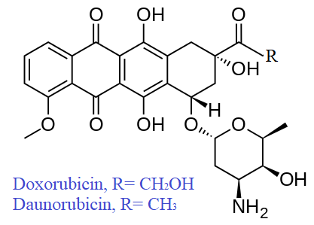
A- Anthracyclines :
Daunorubicin & Doxorubicin
(Active against acute leukemias)
(active against broad spectrum of tumor, including both solid tumor and hematological).
* anthracyclines are tetracycline rings w⁻ sugar moiety.
* both r- intercalating that block synthesis of DNA & RNA.
* ACTs on S phase of cell cycle.
*Doxorubicin is the most important anticancer drug available b₋ of its broad spectrum of activity.

Slide 4
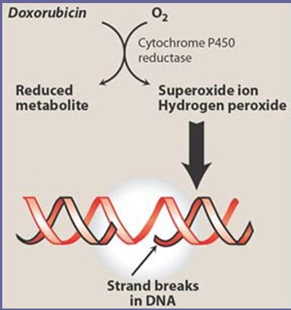
So,they :
1. intercalate (.) base pairse.
2. inhibit Topoisomerase II.
3. Generate free radical.
They block RNA & DNA synthesis
& cause strand scission.

Slide 5
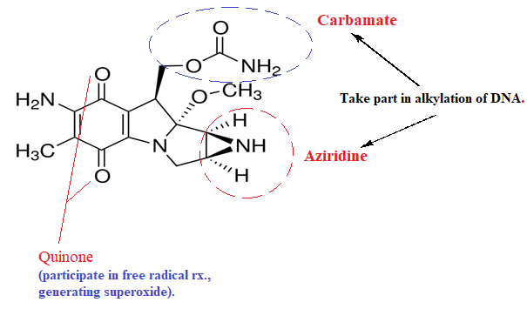
b. Mitomycin C
Mechanism of action: alkylate DNA & therapy causes strand breakage & inhibition of DNA synthesis.

Slide 6
SAR (Anthracycline antibiotics) → Closely related to tetracycline
1. Complete structure is a glycoside (Sugar and aglycone) require for activity.
2. Amino group on daunosamine sugar important for activity.
3. C-13 carbonyl can reduced to alcohol generate inactive (or less active) metabolite, the larger R₂ group, the slower this reaction takes place and the more active the anthracycline as in doxorubicin.

Slide 7
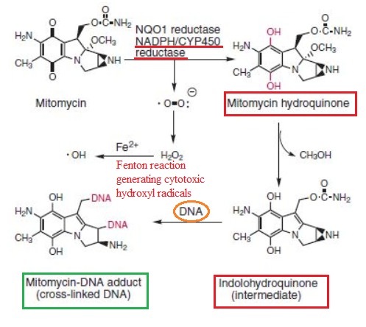

Slide 8
C- Actinomycin D
- Intercalates DNA and prevent ( DNA transcription & mRNA synthesis.
* it is given I.V. (its clinical use is limited to the ttt of trophoblastic(gestational) tumors and ttt of pediatric tumors.

Slide 9
* Actinomycins binding tightly to double helical DNA and thereby prevents it from being an effective template for RNA synthesis. Intercalation may also result in inhibition of topoisomerase enzymes.
* Note::- The main biochemical consequence of the intercalation of actinomycins into DNA is the inhibition of DNA and RNA synthesis. This inhibition eventually results in depletion of RNA and proteins and leads to cell death.

Slide 10
SAR;
1. Changes in substituents on the actinomycins, influence their binding to DNA, usually by making it less effective.
2. Opening a lactone ring or changing the stereochemistry of an amino acid abolishes activity.
3. Replacement of the 4- and 6- methyl groups by other substituents lead to reduces the activity of actinomycins.
Replacement of the 2-amino group also reduces activity.

Slide 11
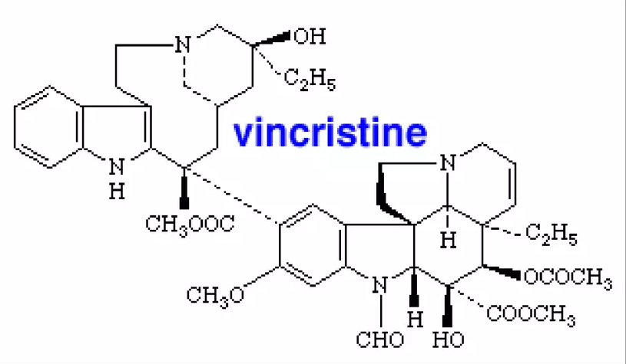
Natural plants
Vinca alkaloids:
-obtained from the plant vinca rosea.
- Inhibit mitosis.
-Bind To tubulin and inhibit its polymerization into microtubules,preventingg spindle formation in dividing cells and causing arrest at metaphase.
- Cell cycle specific and phase specific.
1- Vincristine uses: childhood leukemias childhood tumors-wilm’s tumor, neuroblastoma, Hodgkin’s disease.

Slide 12
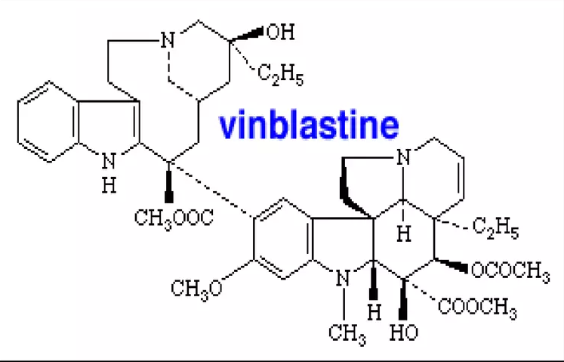
Vinblastine: uses:
- Hodgkins disease
- Lymphomas
- Carcinoma breast
- Testicular tumors

Slide 13
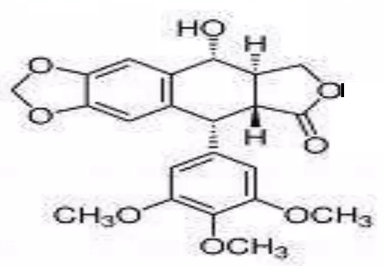
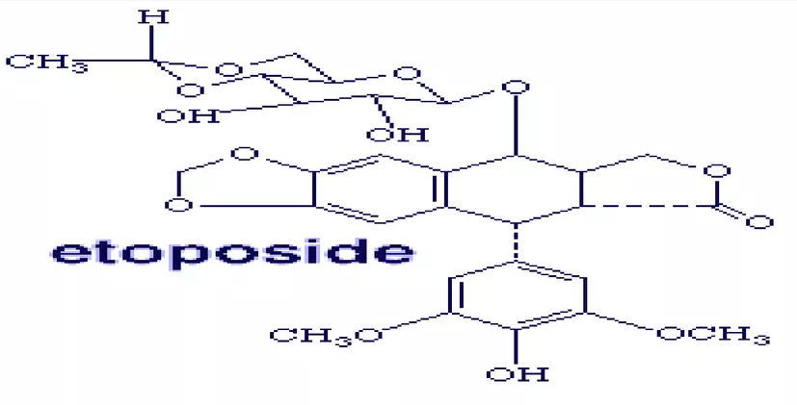
Podophyllum:
1. Podophyllotoxin: uses:
- in ttt of smalll cell carcinoma of lung, prostrate and testicular carcinomas.
2. Etoposide

Slide 14
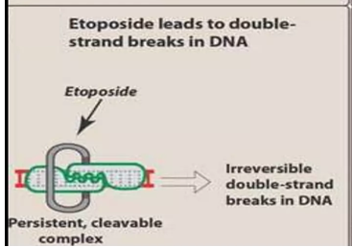
MOA of Podophyllum :
1. Acts by inhibiting topoisomerase II, leads to double-strand breaks in DNA.
2. These drugs are most active in late S & early G2 phase.

Slide 15
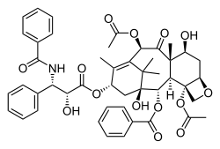
Taxenes:
1. Paclitaxel (PTX), sold under the brand name Taxol among others, is a chemotherapy medication used to treat ovarian cancer, esophageal cancer, breast cancer, lung cancer, Kaposi's sarcoma, cervical cancer, and pancreatic cancer. It is administered by I.V. injection.

Slide 16
MOA of Taxol(paclitaxel)
- these drugs act by interfering with mitotic spindle.
- they prevent micotubule disassembly into tubulin monomers.
Taxol block cell replication, by inhibiting the depolymerization of tubulin.
* thus, interferes with mitosis causing cell death.

Slide 17
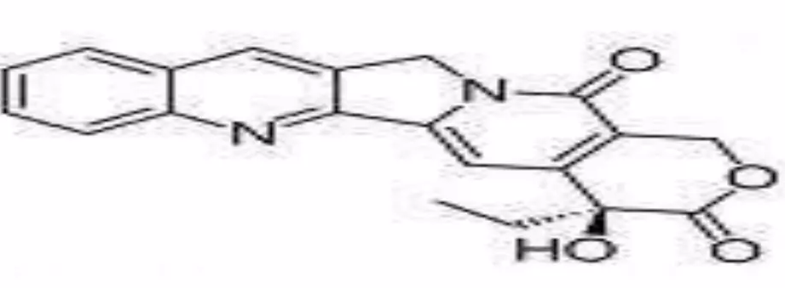
Camptothecin uses:
- Ovarian cancers
- Colorectal cancer
- Cancer of neck & head.
- Liver cancer.
Examples:
1. Camptothecin:
Isolated from comptotheca acuminata (an ornametal tree found in china).
Mode of action:
- Block topoisomerase I.
- Discontinue because of toxicity.

Slide 18
2. Topotecan: semi-synthetic, its topoisomerase I-Inhibitor.
- less toxic.
Mode of action: inhibitor of topoisomerase I, which results in lethal DNA damage during replication as a result of single-strand breaks.

Slide 19
3. Irinotecan HCl (Camptsor):
Is relatively in active prodrug, which is converted by carboxylesterase to SN-38, which is a twofold more potent inhibitor the nuclear enzyme topoisomerase I than is the parent cpd.

Slide 20
Mode of action :
Is one of promising new class of antineoplastic agent known as topoisomerase I-inhibitor. Which this enzyme plays a key role in maintaining the structure of DNA during translation, transcription, and replication.

